Slide 1
Welcome to the English Department! Dr. Cathy Wilcoxson English Department Chair wilcoxson@rowan.edu Office: 3rd Floor, Bunce Hall
New Student Orientation

Slide 2
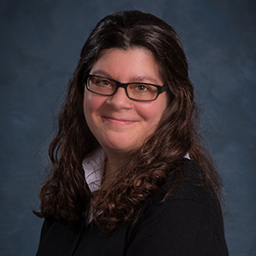
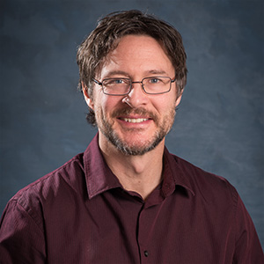
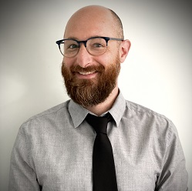
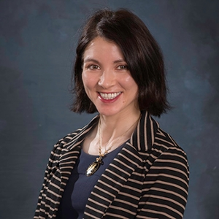
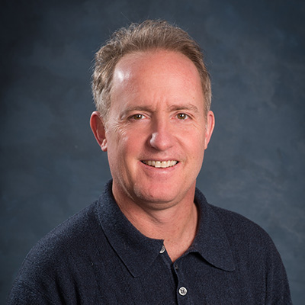
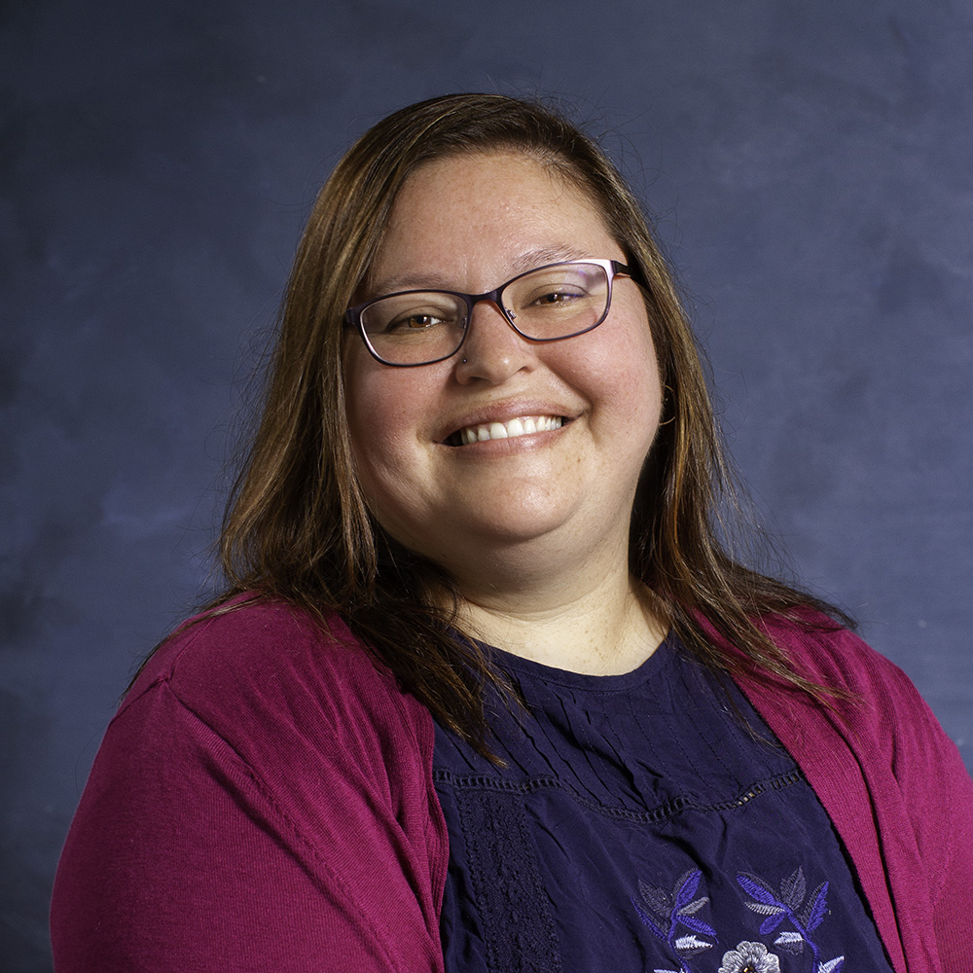
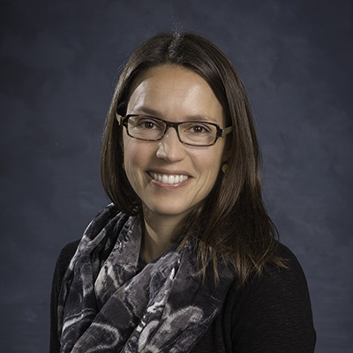
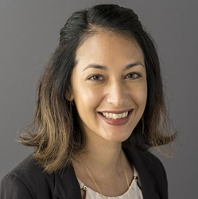
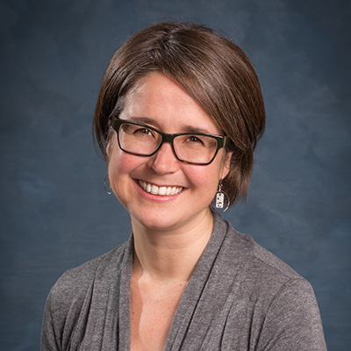
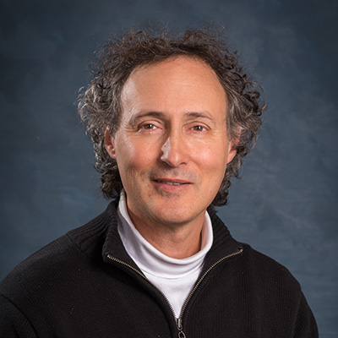
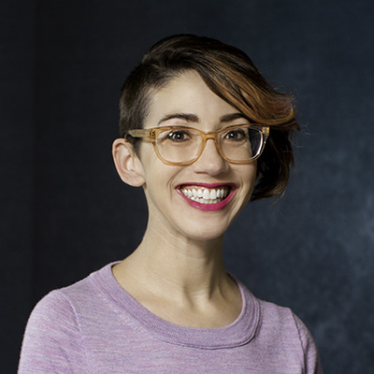
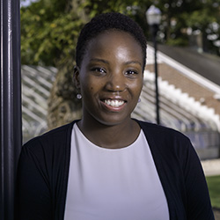
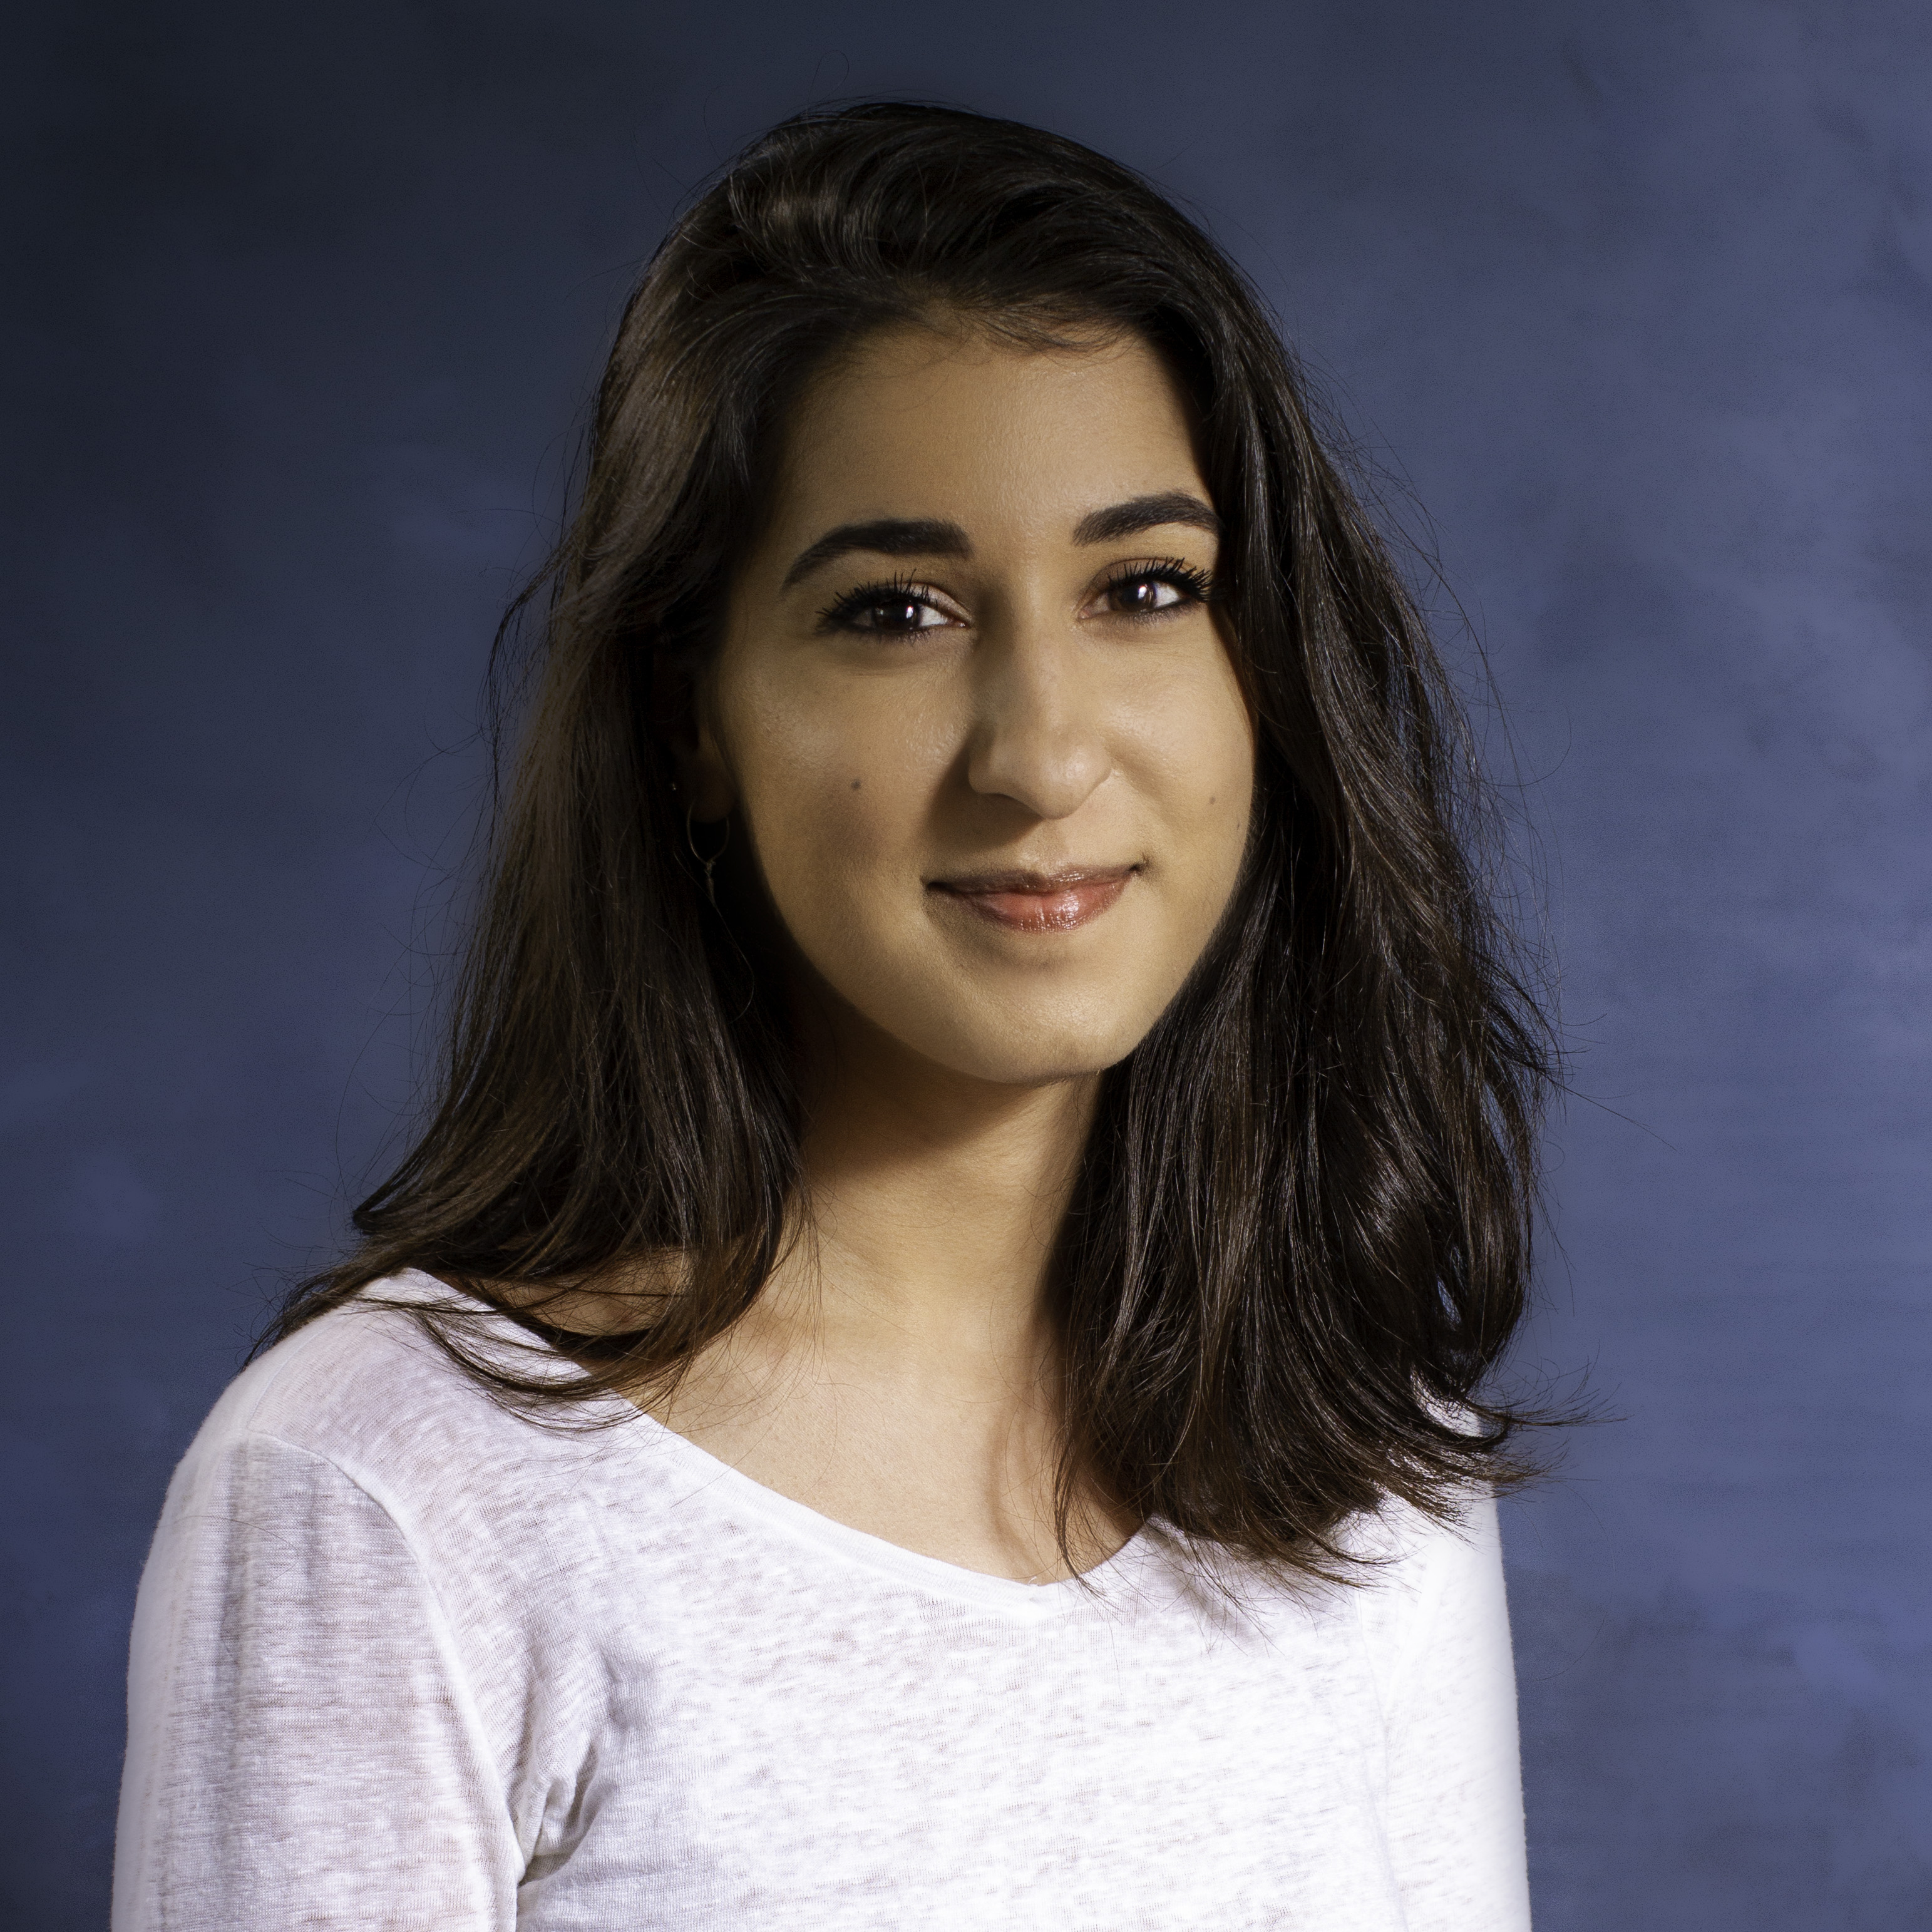
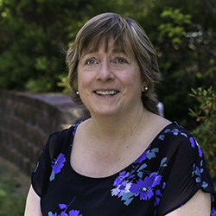
English Department Faculty/Mentors
Dr. Marci Carrasquillo (US Literature; Latinx Literature)
Dr. Joe Coulombe (US Fiction; Native American Literature; Humor)
Dr. Dustin Crowley (Global Anglophone Literature; African Literature)
Dr. Claire Falck (Early Modern British Literature; Shakespeare)
Dr. Bill Freind (US Literature; Modern and Contemporary Poetry)
Dr. Yvonne Hammond (US Literature; Native American Literature)
Dr. Emily Hyde (Global Anglophone Literature; Caribbean Literature)
Dr. Sierra Lomuto (Global Medieval Literature)
Dr. Zena Meadowsong (British Literature; Modern Narrative)
Dr. Bruce Plourde (U.S. Literature; Grammar)
Dr. Kate Slater (Children’s/Adolescent Literature)
Dr. Marquita Smith (African American Literature)
Dr. Christina Solomon (British Literature; Asian American Literature)
Dr. Cathy Wilcoxson (US Literature; Environmental Literature) – Chair
Dr. Claude Willan (18th-century British Literature; Digital Humanities)

Slide 3
Our Current Students
Approximately 200 English majors
English
English & Elementary Education
English & Subject Matter Education (SME) and English Accelerated (CADP)
36 credits in English
Additional students in English major courses:
English minors
21 credits in English
Liberal Studies majors with a sequence in English
18 credits in English
Literacy Studies majors (College of Education)
9 credits in English
American Studies majors
General education students (in LIT courses)

Slide 4
Please introduce yourself! What’s your name? Where are you from? Why are you planning to major in English?
Our New Students

Slide 5
Why Major in English? (Or: “What are you going to do with that?”)
New Student Orientation

Slide 6
English majors . . .
Gain vital skills, knowledge, values, and perspectives;
Gain professional experience;
Get jobs in a wide variety of fields;
Make excellent money;
Love what they do!

Slide 7
English majors . . .
Gain vital skills, knowledge, values, and perspectives:
Learn to read like scholars:
Cultivate concentrated, absorptive, “close” reading:
reading not just for what you expect but for what’s really there (texts will surprise you!);
understand how works of literary art are made.
Gain cultural and historical knowledge:
Know literary history: Where did we come from? Where are we going?
And know why these things are important:
Study how literature not only reflects but shapes the society within which it is written.
Be a savvy reader of all texts: Literature offers a critical awareness of our world both in and outside of the classroom.
Language not only represents, but can change the world!

Slide 8
English majors . . .
Gain “real-world,” transferrable skills:
Read and think critically.
Write clearly.
Argue logically and persuasively.
Conduct independent analysis and research.
Cultivate cultural knowledge and sensitivity.
Be a good human (English is a Humanities discipline!).
And learn how to learn!
Your years in college can’t prepare you for every new challenge (especially the ones we don’t know about yet). But if you can learn, you will always be prepared.
Gain professional experience!
Take advantage of CHSS Match internships
Visit the Center for Professional Success
Learn to translate your what you love into what you can do.

Slide 9
English majors . . .
Learn to translate what you love into what you can do:
Surveys show that more than 80% of employers want the so-called “soft skills”:
Communications skills
Close-reading papers build writing and argumentation skills;
Class presentations hone your public speaking abilities;
Collaborating in class prepares you for life—and the workplace!
Experience in research and writing
That Senior Seminar paper you wrote on, say, Sylvia Plath?
You identified a research question/problem; developed a hypothesis; conducted research to support that hypothesis; produced a 15-page document reporting your findings.
Values and perspectives
Coursework helps you cultivate intellectual curiosity, creativity, independence;
It helps you prepare to make a difference in the world:
Employers increasingly ask for dispositional abilities, e.g., “bi-cultural agility”; “knack for making the complex simple”; “ability to find answers to ambiguous situations.”
Source of survey data: National Humanities Alliance

Slide 10
English majors . . .
Get jobs in a wide variety of fields:
Education (teaching and higher ed);
Publishing; journalism; professional writing;
Cultural-sector jobs (arts jobs, non-profits);
Advertising, human resources, accounting, tech-sector jobs;
Professional jobs: medicine, law, business.
Humanities majors outscore all other majors on the LSAT, MCAT, and GMAT. Source: National Humanities Alliance
Medical schools, especially, want to recruit Humanities graduates:
Humanities majors are accepted to med school at a higher rate than all other majors;
do as well as or better than STEM majors in med school;
and “demonstrate higher levels of … empathy, tolerance for ambiguity, wisdom, emotional appraisal, self-efficacy, and spatial reasoning—all important in being a competent, good doctor.” Source: “To Be a Good Doctor, Study the Humanities”
And many more!

Slide 11
English majors . . .
Make excellent money
Surveys show that median income for graduates with BAs in English: $50K/year.
English BAs are upwardly mobile!
Humanities graduates make more as they progress in their careers;
They are more upwardly mobile than graduates in many other fields (including Business Management and Accounting, Engineering, and Health and Medical Sciences).
And they often make as much (or more!) over their lifetimes as those in higher-paying fields.
Sources: HumanitiesIndicators.org and National Humanities Alliance

Slide 12
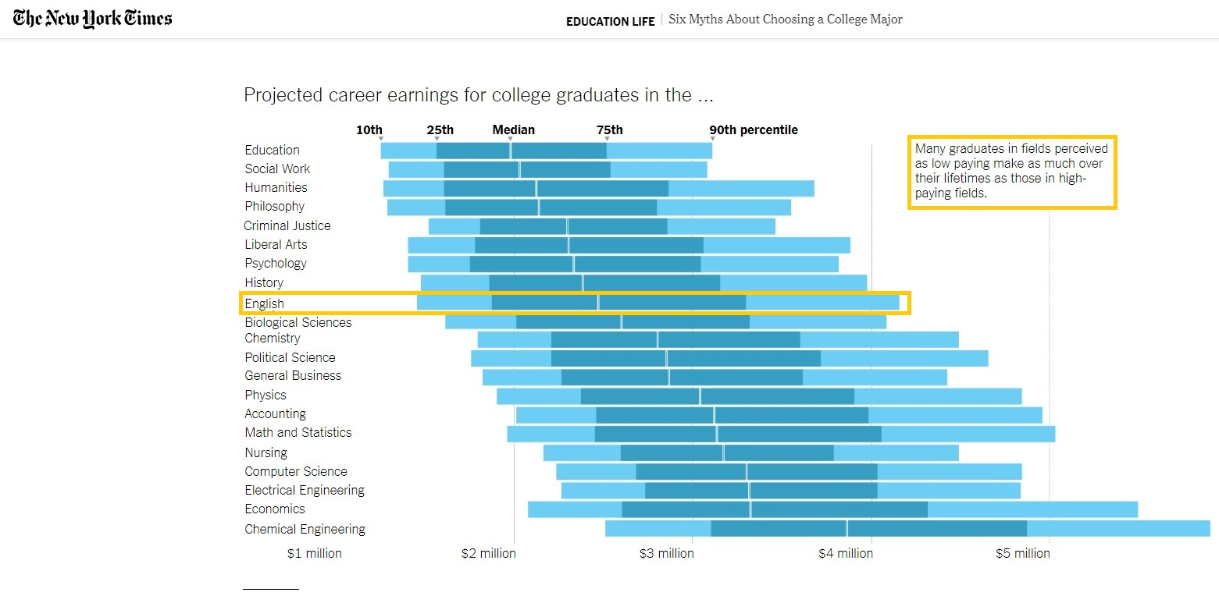
English majors . . .
Source: “Six Myths About Choosing a College Major,” NYTimes (2017)

Slide 13
English majors . . .
Love what they do!
87% of Humanities graduates report that they are happy with their jobs.
72% report being “deeply interested” in the work they do on a daily basis.
70% report that they have the “opportunity to do what [they] do best every day.”
78% report living their “best possible life,” and 90% believe they are either living their best possible life or will be within five years.
Sources: HumanitiesIndicators.org and National Humanities Alliance

Slide 14
Advising and Mentorship
New Student Orientation

Slide 15
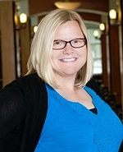
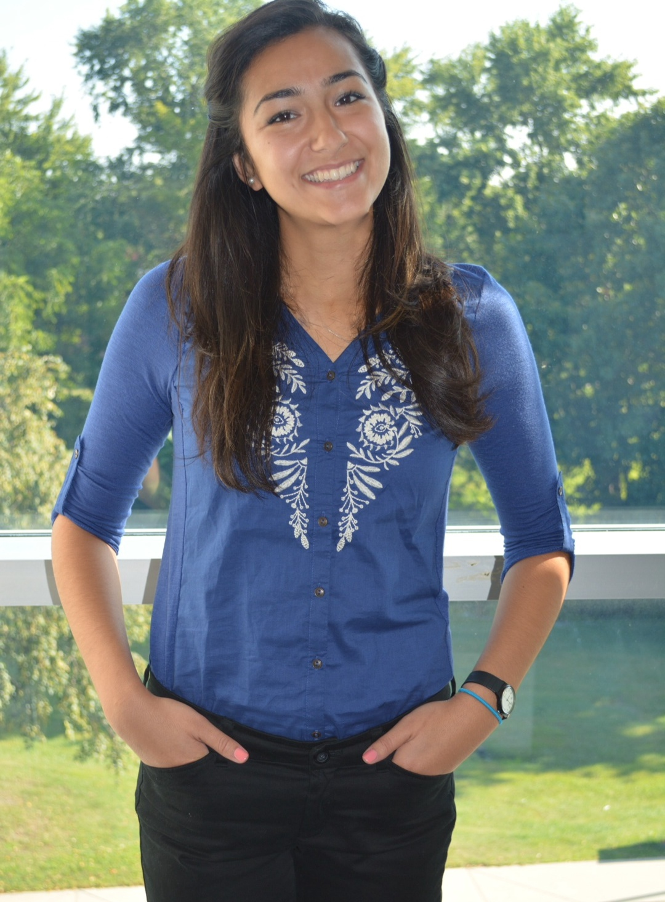
Get advising regularly!
Advisor to English Majors:
Ms. Christine Larsen-Britt
Office: Bunce Hall, suite 218
Email: larsen-britt@rowan.edu
Advisors to English/SME and English Accelerated:
Ms. Nadia Rahin
Office: 2079 James Hall
Email: rahin@rowan.edu
Advisors to English/Elementary Education students:
Ms. Lindsay Rosato
Email: rosatol@rowan.edu
and
Mr. Charles Foster
Email: foster@rowan.edu

Slide 16
Important Advising Links
Banner
Degree Works/GRAD (Graduation Requirements & Advising Database)
Requires ID and password
Section tally (shows course availability)
English Department Program Guide

Slide 17
Seek out faculty mentors!
You can also go to your professors for advising—and mentorship!
According to a recent study, faculty mentorship is the best predictor of
students’ academic success in college;
professional success and well-being after graduation; and
value for money: the sense that education was “worth the cost.”
Visit your professors in office hours!
All full-time faculty reserve four hours for their students every week.
You might think they’re scary, but they’re not! And they care!
Source: Strada Gallup Alumni Survey 2018

Slide 18
Your Curriculum Rowan Core requirements + English major requirements + Free electives = graduation!
New Student Orientation

Slide 19
Rowan Core requirements
Literacy | Semester Credit Hours
Artistic Literacy | 3 SCH (1 course)
Communicative Literacy | 9 SCH (3 courses)
Composition I Composition II Public Speaking
Humanistic Literacy | 3 SCH (1 course)
Global Literacy | 3 SCH (1 course)
Scientific Literacy | 3 SCH (1 course)
Quantitative Literacy | 3 SCH (1 course)

Slide 20
Special Core requirements for English majors
English majors must take either:
Western Civilization to 1660 (Humanistic Literacy) or
US History to 1865 (Humanistic Literacy) or
A semester of a world language.
and
Western Civilization since 1660 (Humanistic Literacy) or
US History since 1865 (Humanistic Literacy) or
A semester of a world language.
Note also:
Rowan Seminar (RS): required for all first-year students
Writing Intensive (WI)
Experiential Learning requirement
D/I (Diversity and Inclusion, English Dept. requirement)

Slide 21
Required English courses: 12 total
Introductory methods sequence (2 courses)
Critical Methods I for English Majors (02.101)
Critical Methods II for English Majors (02.202)
Historical surveys (4 courses)
British Literature I (02.309)
British Literature II (02.311)
U.S. Literature I (02.313)
U.S. Literature II (02.315)
200-level electives (2 courses)
Shakespeare I (02.345)
Upper-level (300/400-level) electives (2 courses)
Note: Education majors substitute American English Grammar (05.301) for one upper-level elective course.
Senior Seminar (WI) (02.499)

Slide 22
At least one English elective must be chosen from the English Department’s designated “Diversity and Inclusion” (D/I) course bank:
Diversity and Inclusion
Gender, Sexuality, and Literature (ENGL 02.200)
Multiethnic Literatures of the United States (ENGL 02.218)
World Mythologies (ENGL 02.231)
African American Literature I (ENGL 02.354)
African American Literature II (ENGL 02.355)
Asian American Literature (ENGL 02.360)
Native American Literature (ENGL 02.362)
US Latino/a Literature (ENGL 02.365)
Special Topics in Multiethnic American Literatures (ENGL 02.470)
Global Modernisms: [subtitle] (ENGL 02.473)
Special Topics in Global Literatures in English (ENGL 02.475)

Slide 23
Degree overview in Semester Credit Hours (SCH)
* Consider adding a minor or a certificate!
And/or consider acquiring a concentration within the major!
Concentration in English for Future Educators
Concentration in Multiethnic American Literatures
Concentration in Shakespeare Studies
Concentration in Global Literatures in English
 | Semester Credit Hours
Total credits required in English (12 courses) | 36 SCH
Total credits required for graduation | 120 SCH
Calculate how much free elective credit you have after deducting Rowan Core and major courses.*

Slide 24
Possible schedule for transfer students
 | Term one | Term two
Year One | Critical Methods for English Majors I US Literature I British Literature I | Critical Methods for English Majors II US Literature II British Literature II
Year Two | 200-level English elective 200-level English elective Shakespeare I | 300/400-level English elective includes American English Grammar 300/400-level English elective Senior Seminar

Slide 25
Academic Integrity & Professionalism
New Student Orientation

Slide 26
Academic Integrity Policy
According to Rowan University policy, students committing any act of academic dishonesty may fail the assignment and/or fail the course, at the faculty member’s discretion.
All violations of Academic Integrity warranting sanctions must be reported to the Provost’s office using the RAIV process. Serious cases will result in a hearing.
Note: We report proven cases to the College of Education if the infraction involves a dual major.
In order to avoid plagiarism, students should provide appropriate documentation whenever quoting, paraphrasing, summarizing, or otherwise using the language or ideas of others.
Do not cut and paste. Revising another writer’s prose—even revising it substantially—is plagiarism unless you properly cite your original source.
Multiple submission (handing in a paper written for one class to another class) is also a form of academic dishonesty and will be treated accordingly.
Most original works, whether your own, your classmates’, or your professors’, are considered the intellectual property of their creator. These works include papers, assignments, exams, course syllabi, lectures, powerpoints, notes, outlines, study guides, etc. Circulating such materials outside the community of a specific class is an intellectual property violation. Note, especially, that uploading your coursework to online sites—even those purporting to be designed for “tutorial” purposes—is prohibited by Rowan’s Academic Integrity policy.

Slide 27
Rowan Success Network/Starfish
Faculty use RSN to raise “flags” if you are in academic trouble.
Faculty can also send you “kudos” for work well done.
You can use RSN to schedule advising appointments.

Slide 28
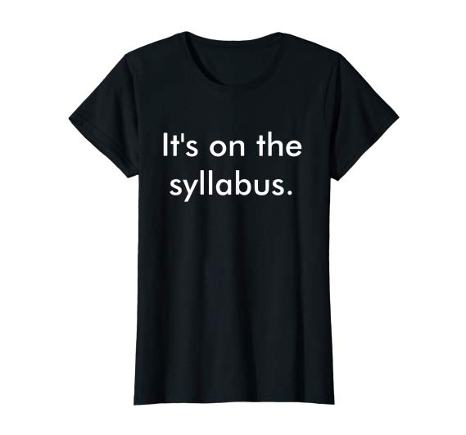
Professionalize!
Your lit classes are preparation for “real life”!
Arrive to class on time, don’t pack up early, don’t come and go.
Meet deadlines.
Communicate with your professors.
Cultivate professional email and office etiquette!
Focus and engage.
Put devices away.
And get out a notebook!
A joint Princeton/UCLA study shows that students learn and retain more when taking notes by hand.
Plan ahead: read the syllabus!
And don’t be afraid to ask questions.

Slide 29
Don’t forget to…
Read your Rowan email daily.
Come to advising every term!
Use GRAD on Banner to chart your progress towards graduation.
In Fall, you will need to register yourself for Spring courses.
Connect with us!
Come by the department (3rd floor, Bunce Hall): we have couches!
Visit me in my office (3rd floor, Bunce Hall) or email me at wilcoxson@rowan.edu.
Visit your other professors in office hours!
Follow us on Twitter: @RowanEnglishDpt
Join us on Linkedin

Slide 30
Questions?

